Slide 1
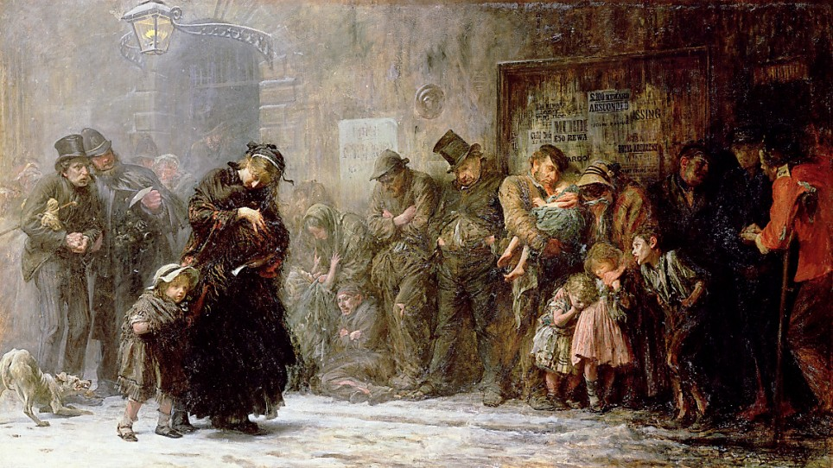
Applicants for Admission to a Casual Ward by Luke Fildes, 1874.

Slide 2
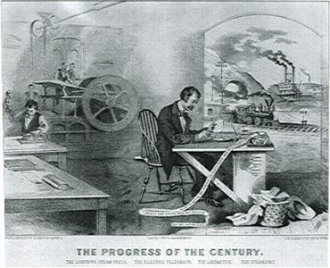

Slide 3
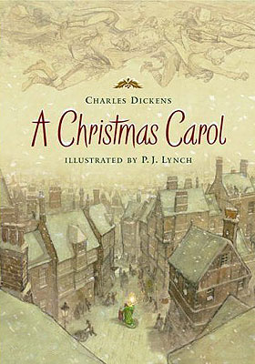

Slide 5
Analyzing Visuals
APPARTS
Author
Place & Time
Prior Knowledge
Audience
Reason
The Main Idea
Significance

Slide 6
Author | Person who wrote, said, created the document. Include title or brief description if applicable. *Speaker
Place and Time | Date, time period, location. *Occasion
Prior Knowledge | What do you know about the context of the document? Include any relevant info about the time period and/or info about the author that shows his/her bias.

Slide 7
Audience | Direct: Who is the author speaking to, writing to? Indirect: Who else is meant to receive the message?
Reason | Why was this document written, said, created? Usually begin with “To…” *Mix of occasion and purpose in

Slide 8
The Main Idea | The main argument of the author. The author’s THESIS.
Significance | So What? Why is the document important in the context it’s created? Ask yourself… Does it set a precedent? Change a policy? Cause a large event or a new direction for a group? Demonstrate a small sample of a larger movement or idea? What does this tell me about the time period?

Slide 9
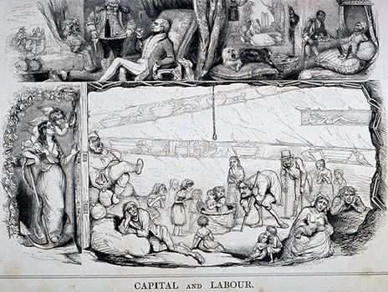

Slide 15
APPARTS your given cartoon

Slide 16
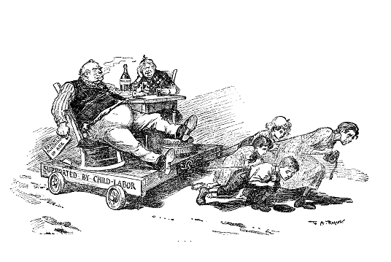

Slide 17
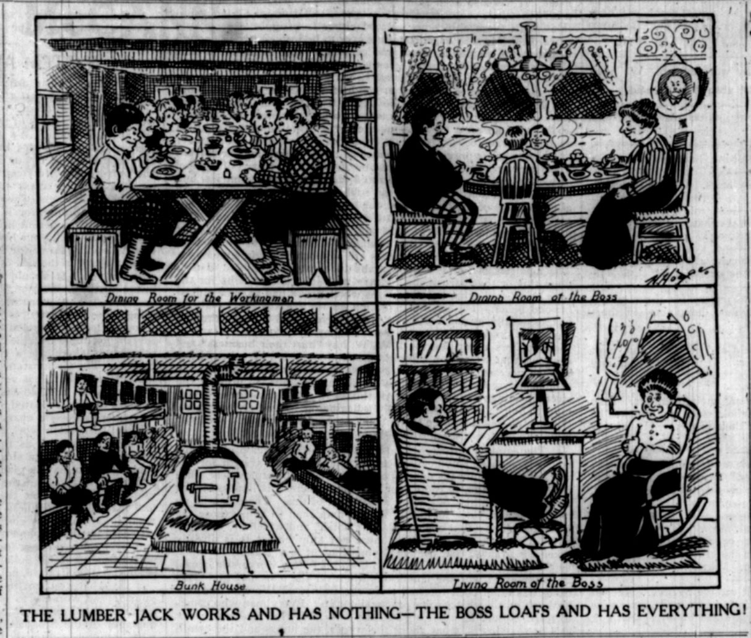
1909

Slide 18
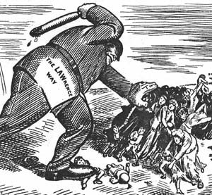
The Lawrence Textile Strike, 1912

Slide 19
